Slide 1
Introduction to Digital Systems
Human (decimal: 0,1,…,9) Most computers (binary: 0,1)
Digital system
Octal, hexagonal → Human’s convenience
Compact representation of binary
Digital system (using binary number) manipulates discrete element
: communication, business transactions, traffic control, space guidance, medical
treatment, weather monitoring, the Internet, many other commercial, industrial,
and scientific enterprises
→ Logic values, signal voltage levels, memory addresses, program
introduction and data
Memory: two state storage elements (cell)
Addressable memory location → A word composed of n bits
Electronic system
i) Analog (analogous: 유사) system: it treats physical amount directly
→ weight, height, voltage, current etc.
ii) Digital (digitus: 손가락) system : it treats physical amount by discrete elements
→ 1) naturally discrete, 2) continuous → discrete
→ In general, base-2 binary number system
iii) Hybrid system: Combination of analog and digital systems
Digital computer
Program: operates on given data
Flexibility
*

Slide 2
Ex) An automobile ignition system: digital system (on/off)
An automobile gas gauge system: analog system (The position of the indicator is an analogy of the level of gasoline in the tank)
Numbers → a means to quantitatively describe
systems and their operation
Hierarchical(계층적)model
of digital system
Digital system (Interconnection of digital module)
Digital subsystem
Digital subsystem
Digital circuit, Digital function device
Digital circuit, Digital functional device
Digital device… Digital device
Digital device… Digital device
Digital device → basic elements such as gates and memory element that formed from resistors, diodes, transistors, capacitors, energy sources
Weather-monitoring system
Temperature subsystem
Wind direction/speed subsystem
Barometric pressure
subsystem
Digital display
: displays temperature
in either degrees centigrade
or degree Fahrenheit
Anemometer
Thermocouple
: translator whose
output voltage is proportional to the ambient temperature
ADC
: analog to digital converter
Weather vane
Barometer
Analysis and design
Physical
system
Math
representation
Logic
Modeling
*

Slide 3
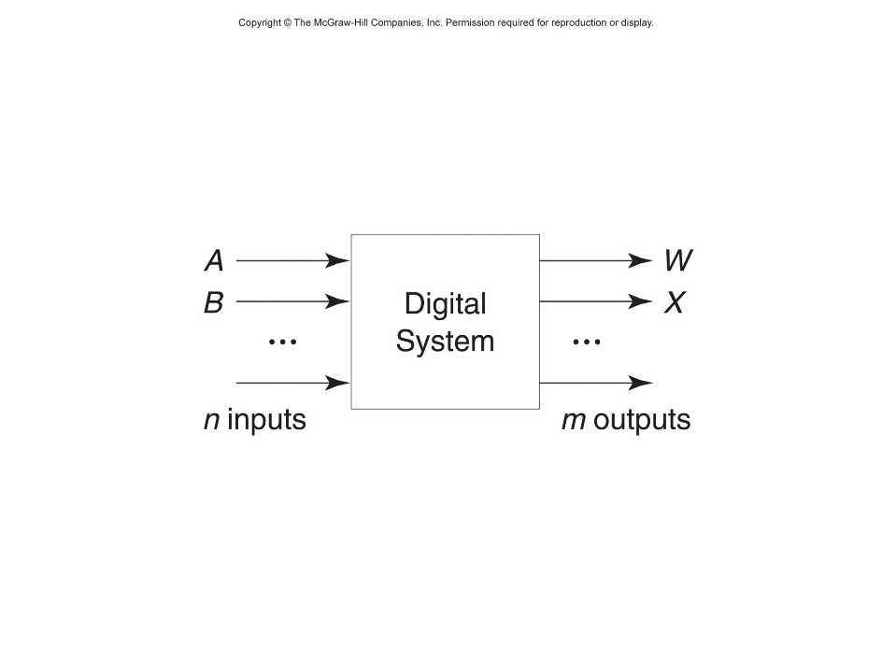
Logic Design
Digital systems: All of the signals by discrete values
Usually, two-valued system (binary, 1 or 0) → more reliable
compared to multivalued systems
Binary digits: bits
Clock: a timing signal (is just another input signal that alternates between 0 and 1 at regular rate)
Combinational: the output depends only on the present value of the input
(Cf. Sequential (memory + combinational logic): it requires memory “feedback” since we need to know something about inputs at an earlier time (previous clock times)
*

Slide 4
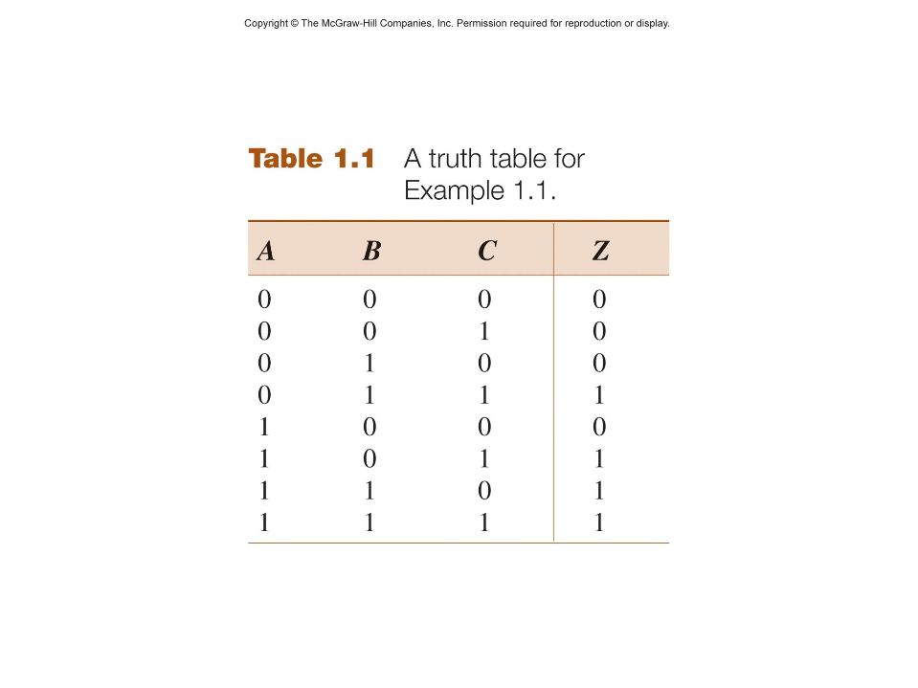
Example : A system with three inputs, A, B, C, and one output, Z, such that Z=1 if and only if (iff) two of the inputs are 1
Coding: inputs and outputs into binary
Physical representation (0V, 5V: switch up, down: magnetic field one direction, another direction) → 0, 1
*

